Slide 1
NH3 from Lake Natron
Zhenqi Luo 2020.12
Notes:
https://doi.org/10.1038/s41598-019-39935-3

Slide 2
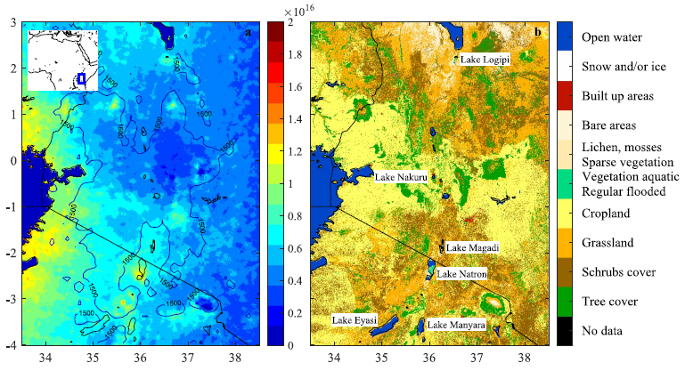
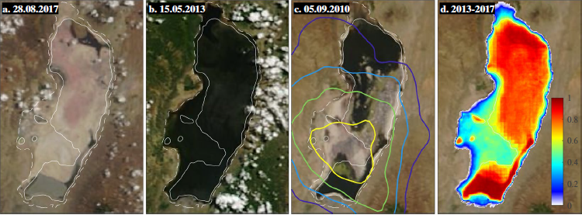
Background information
(Clarisse et al., 2019)
Location:
North Tanzania on the Kenyan border
Eastern Rift Valley
water surface extent: periodically dried out
an archetype soda lake
Sodium (Na)
Carbonate (CO3)
Chlorine (Cl)
pH levels: 9-11.5
productive biologically: well-adapted plankton
Waterbird species: lesser flamingo
Population: 1000+ each village
Notes:
background information on the lake
Lagoons
from the surrounding rocks and that as a closed basin, accumulated over time
chemical composition
Gelai mudflat

Slide 3
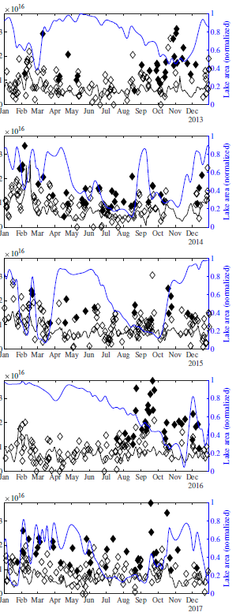
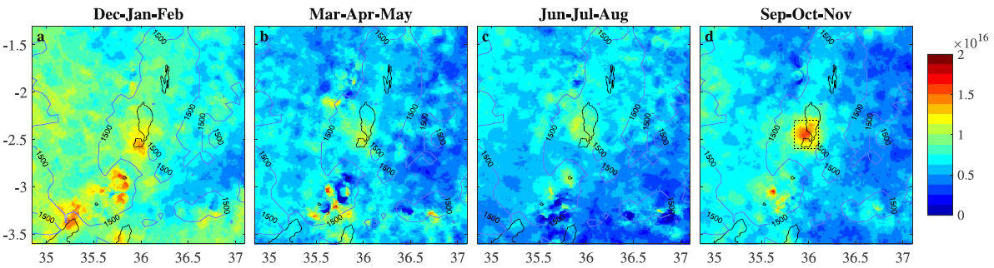
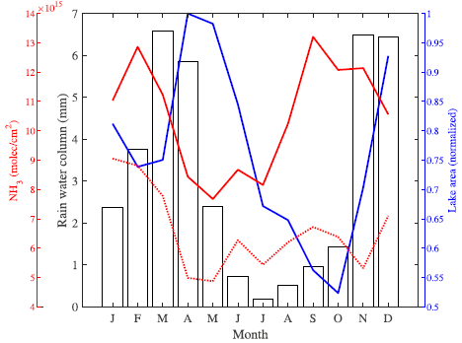
NH3 at Lake Natron
(Clarisse et al., 2019)
Where: lower-half of the lake
When:
the largest: Sep to Nov
the lowest: Mar to Aug
Seasonality
Background double in Jan, Feb
Wet seasons
Nov-Dec: short
Feb-May: long
Dry seasons: May-Oct
lake area: smallest at the end of the dry season
link with lake surface area: relate closely
Occur throughout the year
Episodic and separated at times
long wet
dry
short wet
Notes:
2014 and 2017
2013 and 2016

Slide 4
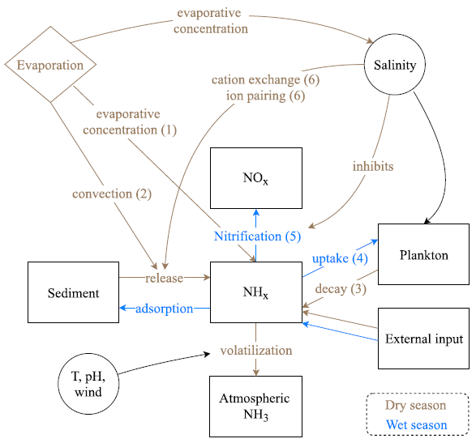
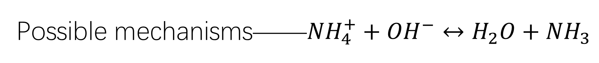
Possible mechanisms——${NH}_{4}^{+}+{OH}^{−}↔H_{2}O+{NH}_{3}$
Evaporative concentration: the available NH3 concentrates increases the surface-atmosphere concentration gradient
Convection: dissolved NH3 can be transported to the surface
Decay of plankton: breakdown and ammonification of the biomass
Assimilation: a decreased uptake of NH3
Nitrification: inhibited beyond a certain salinity threshold
Cation exchange: determines how much NH+4 can be reversible adsorbed on soil colloids
Ion pairing: stimulate diffusion of NH+4 out of the sediment
(Clarisse et al., 2019)

Slide 5
Questions?

